Slide 1
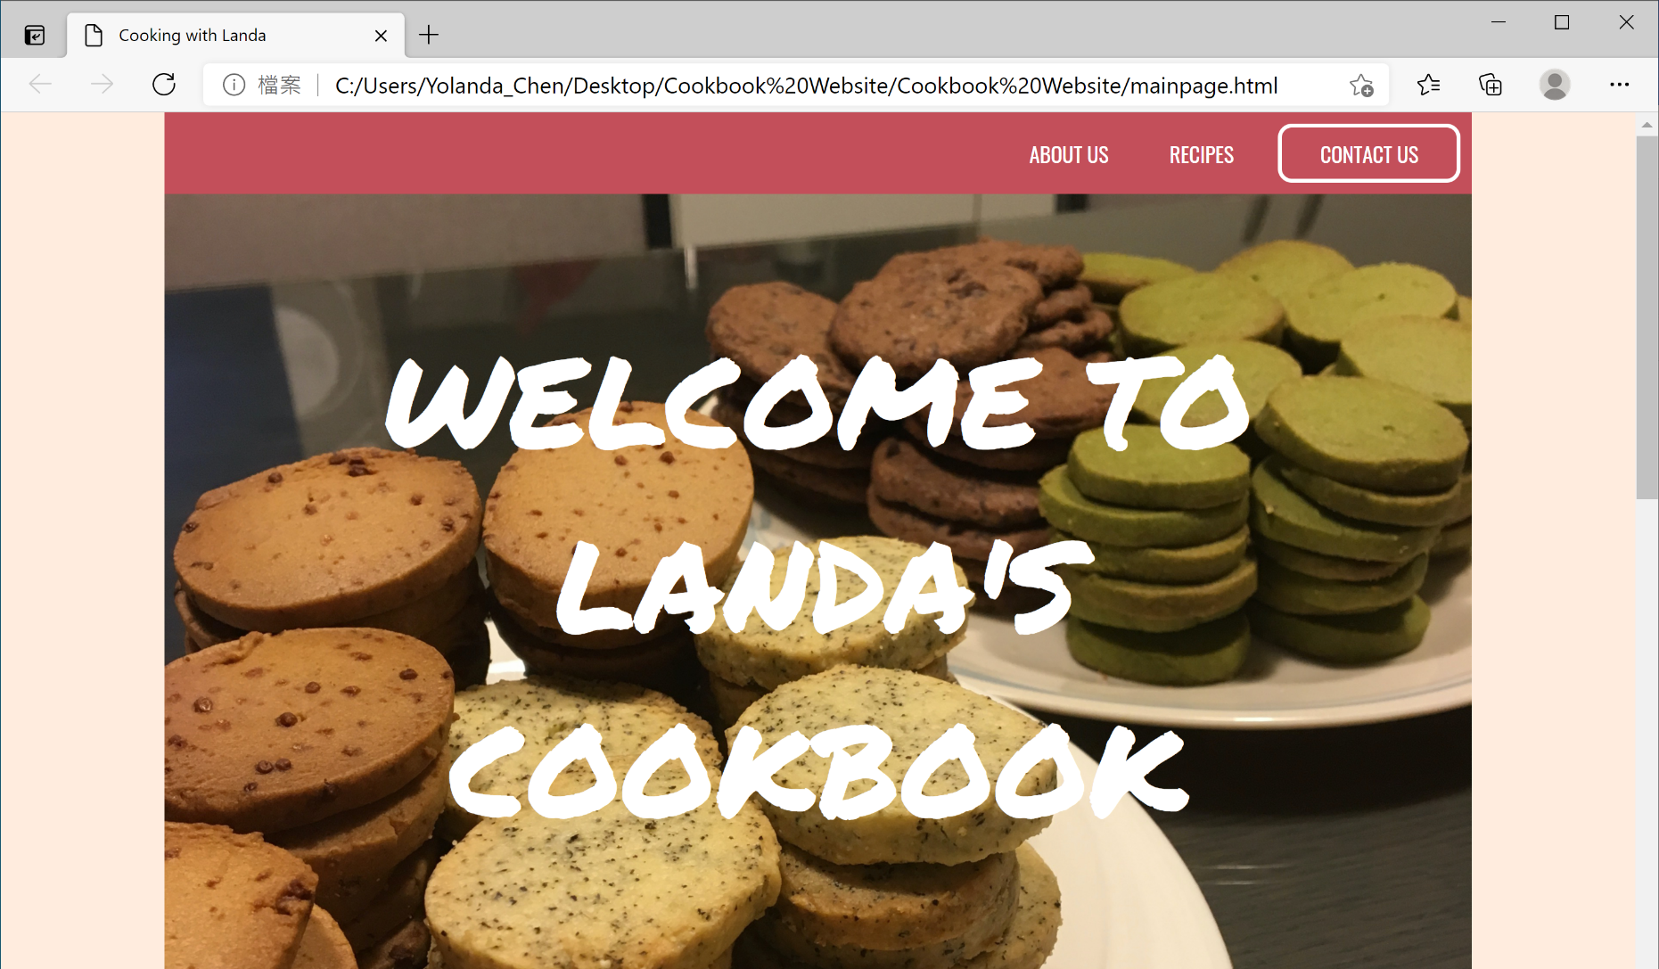

Slide 2


Navigation Bar Hover
Hover to see colors change

Slide 3
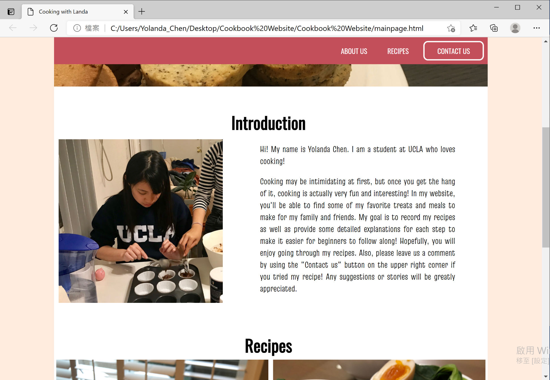
Introduction
Clicking “About Us” tag will jump to the Introduction section
Navigation bar position is fixed
Paragraph text will adjust font size according to window size

Slide 4
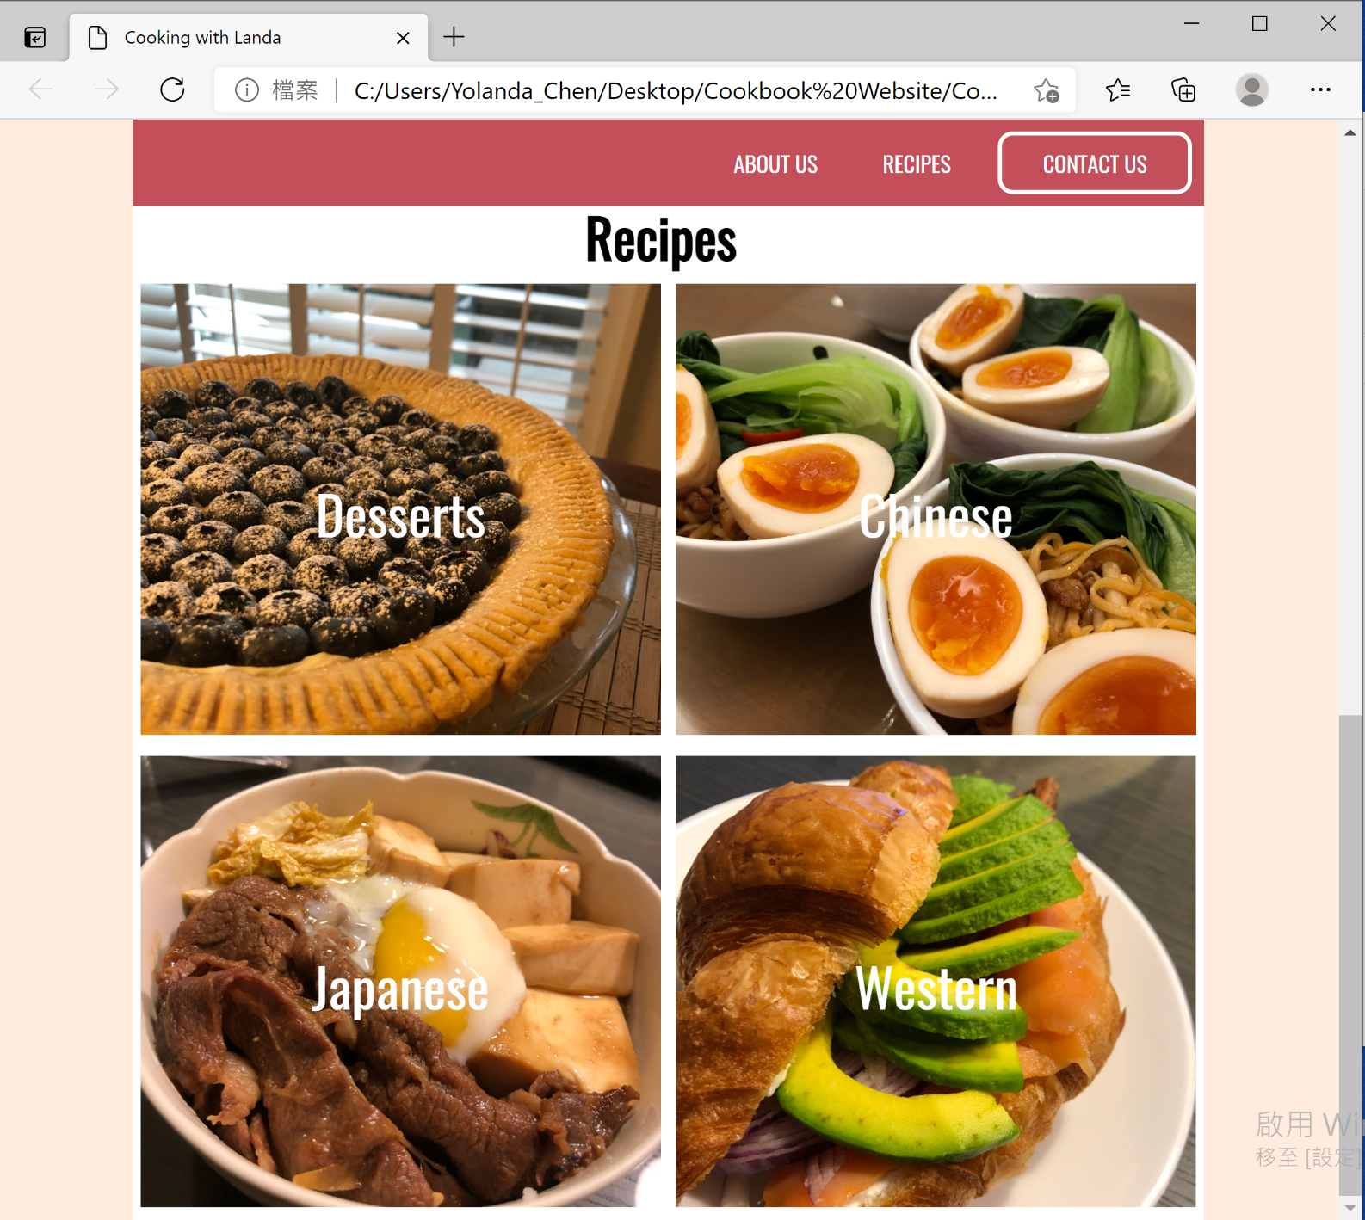
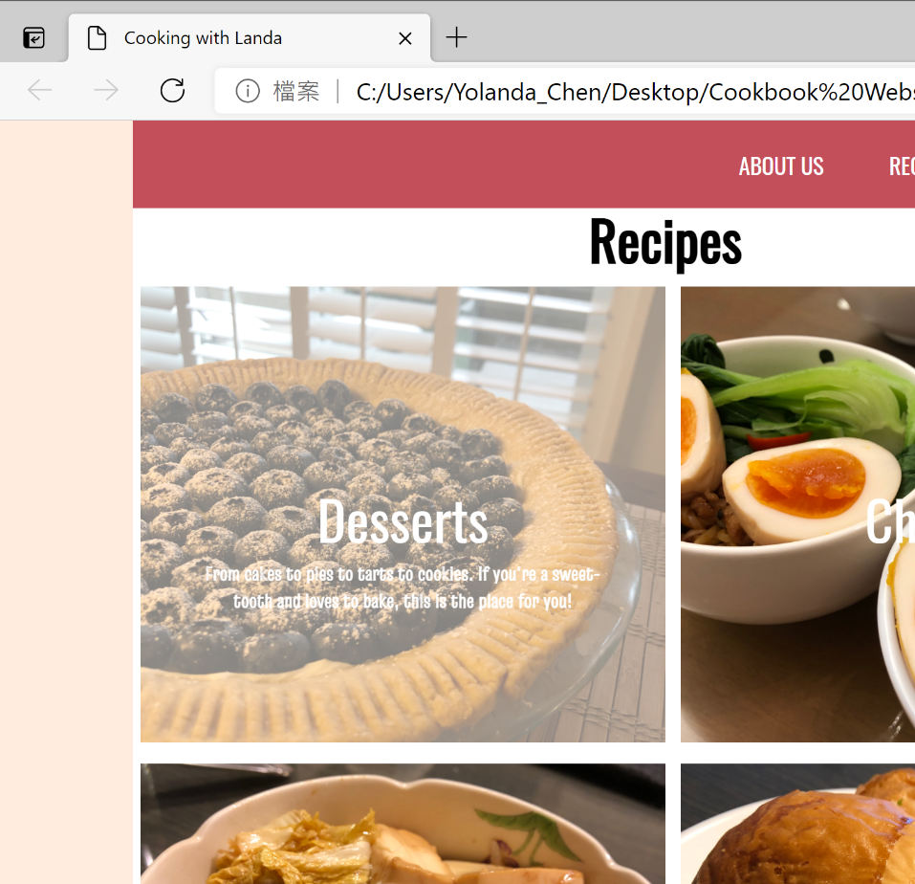
Recipe Section
Clicking “Recipe” tag will jump to the Recipe section
Hovering over the image block will decrease the opacity of the image as well as display a short description

